Slide 1
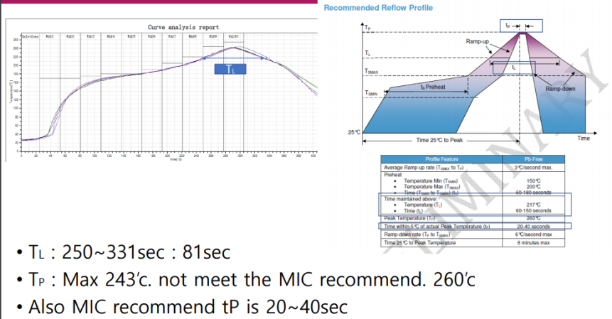
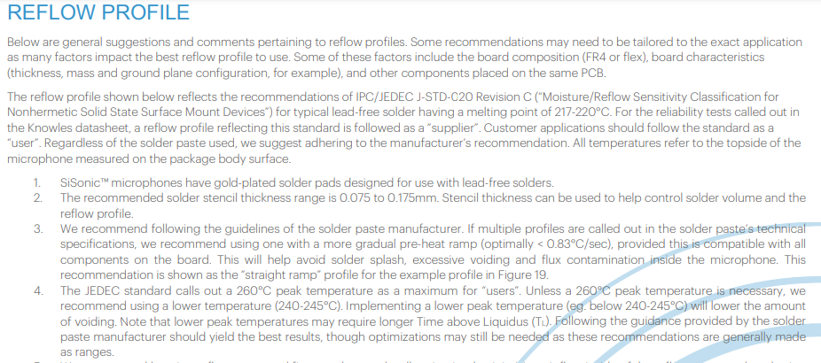
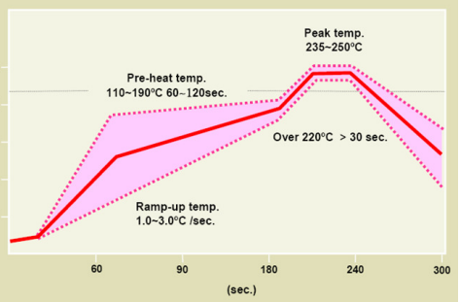
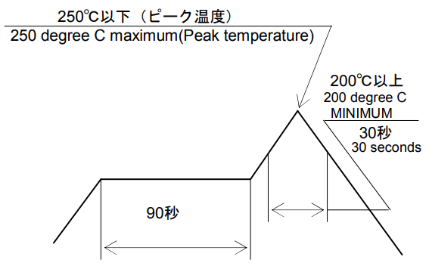
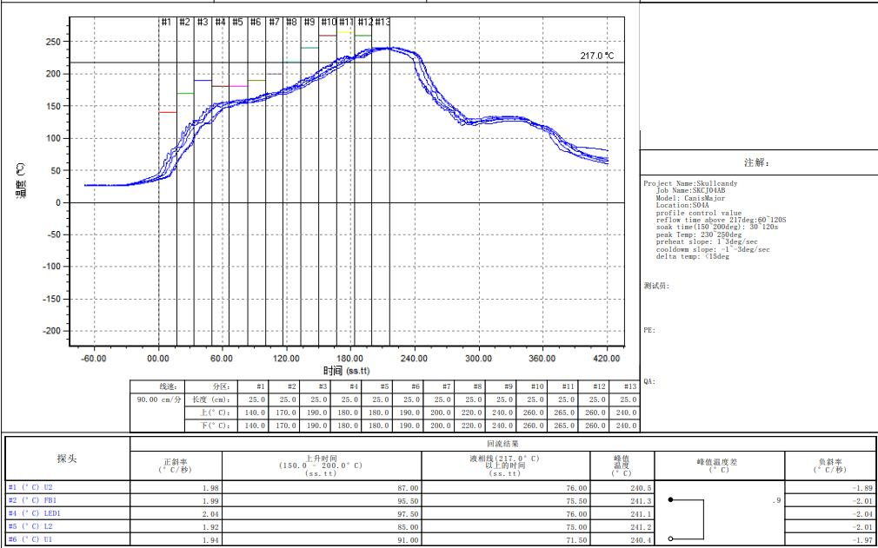
The reflow profile is not followed MIC recommend:
The peak temperature in data sheet is maximum resistance of component. It is not ideal peak temperature
As confirmed with vendor, Vendor sent a recommend profile for us.
Our profile conditions is set up to balance conditions of all materials on PCB
Please see recommend reflow profile and sample profile vendor sent before
About t_{p} time: We will study how to control it
Solder paste 591.00046.005
FFC connector 345.00470.005
SISONIC’s suggestions

Slide 2
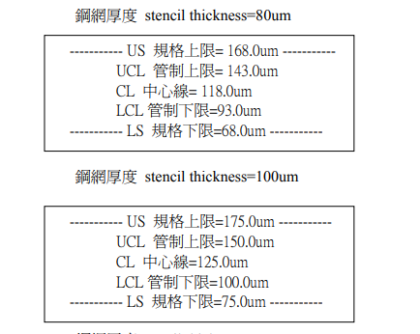
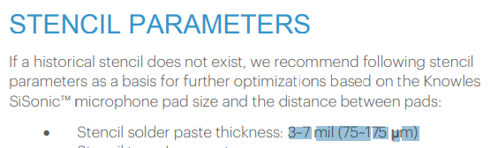
2. SPI (Solder Paste Inspection)
The pass/fail criteria is too rough. stencil is 100um and US=175um.
please set the US =150um &LS = 75um:
That is the standard to control the thickness of solder paste in Foxconn for stencil thickness 100µm. It is used for all of product at Foxconn.
Vendor SISONIC also suggests solder paste thickness is 75~175 µm
We also control solder paste thickness: UCL=150µm & LCL= 100µm
3. If it is difficult to adjust only the MIC board, I also recommend that separate MIC board. it will be more easy to reduced void on the MIC.
MIC board also has FFC connector and other component, solder paste… How will we adjust if we separate MIC board?

Slide 3
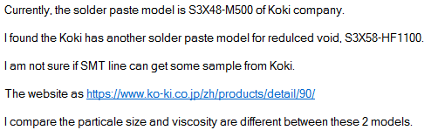
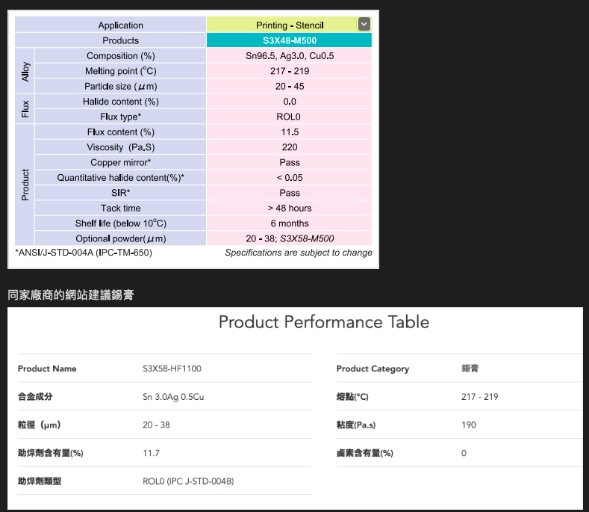
4. Try to get sample solder pastes and do some DOE for test if the void can reduce or not.
Please PM/MPM help to check whether can get sample to do DOE or not
Finally, Please help to ask the information, parameters of stencil, solder paste, reflow profile from vendor, which has been used in DOE or other project OK.
Otherwise, Please help to ask vendor arrange their employer come our factory to support us solve issue

